Slide 1
JAVA Programming Day 1
Introductions
Expectations
Class Website
Assignments
Text Pad, Eclipse
Checkout Text Book
Java Programming, Eighth Edition

Slide 2
Chapter 1:
Creating
Java Programs

Slide 3
Chapter 1 Goals
Define basic programming terminology
Compare procedural and object-oriented programming
Describe the features of the Java programming language
Analyze a Java application that produces console output
Compile a Java class and correct syntax errors
Run a Java application and correct logic errors
Add comments to a Java class
Create a Java application that produces GUI output
Find help
Java Programming, Eighth Edition

Slide 4
Learning Programming Terminology
Computer program
  A set of written instructions that tells the computer what to do
Machine language
  The most basic circuitry-level language
  A low-level programming language
Java Programming, Eighth Edition

Slide 5
Java
Log into computer
20 minutes of lecture
System.out.println(“X X X”)
Debugging exercises downloaded from GitHub
Game Zone page 51 #1 –Understanding Randomness
Exercises 1-10 page 49
Case problem page 51 # 1-2
Objective
Students should be able to understand basic Java structure dealing with classes
Java Programming, Eighth Edition

Slide 6
Learning Programming Terminology (cont’d.)
High-level programming language
  Allows you to use a vocabulary of reasonable terms
Syntax
  A specific set of rules for the language
Program statements
  Similar to English sentences
  Commands to carry out program tasks
Java Programming, Eighth Edition

Slide 7
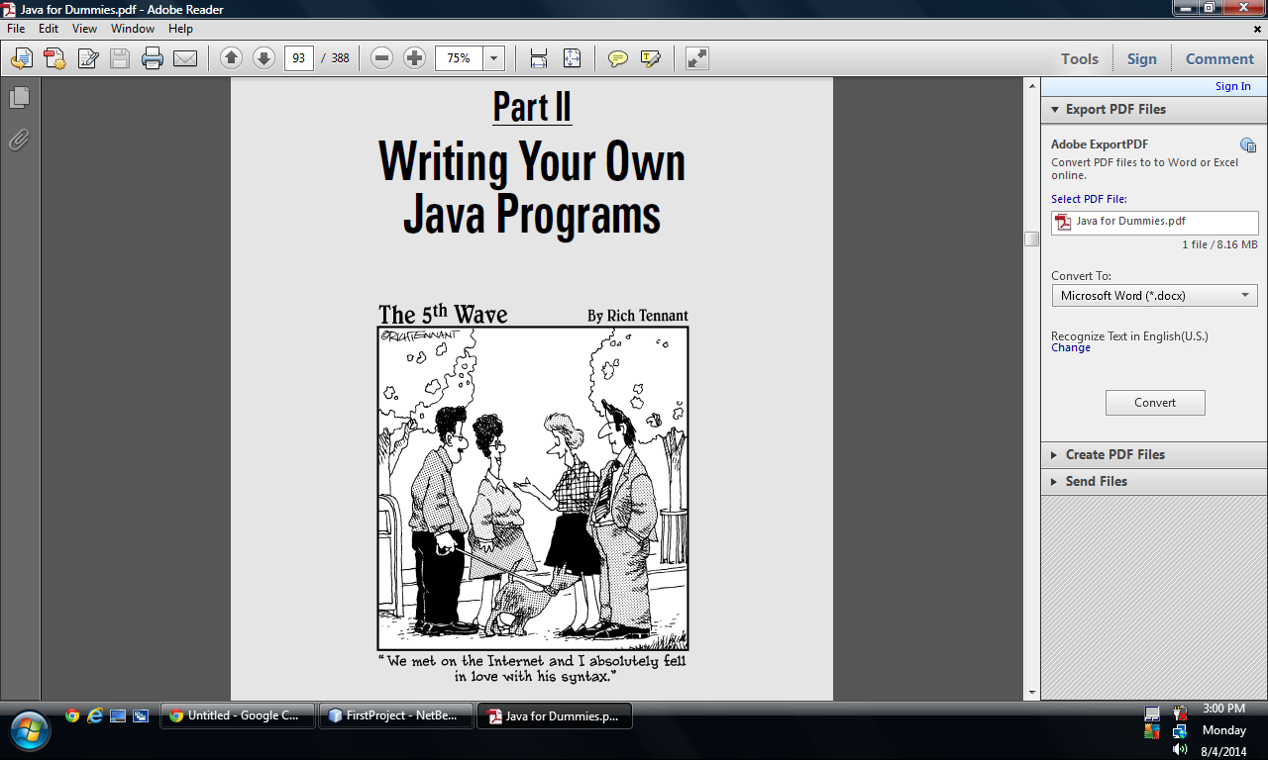
Java Programming, Eighth Edition

Slide 8
Learning Programming Terminology (cont’d.)
Compiler or interpreter
  Translates language statements into machine code
Syntax error
  Misuse of language rules
  A misspelled programming language word
Debugging
  Freeing program of all errors
Logic errors
  Also called semantic errors
  Incorrect order or procedure
  The program may run but provide inaccurate output
Java Programming, Eighth Edition

Slide 9
Comparing Procedural and Object-Oriented Programming Concepts
Procedural programming
  Sets of operations executed in sequence
  Variables
    Named computer memory locations that hold values
  Procedures
    Individual operations grouped into logical units
Object-oriented programs
  Create classes
    Blueprints for an object
  Create objects from classes
  Create applications
Java Programming, Eighth Edition

Slide 10
Comparing Procedural and Object-Oriented Programming Concepts (cont’d.)
Object-oriented programming was used most frequently for two major types of applications
  Computer simulations
  Graphical user interfaces (GUIs)
    Not all object-oriented programs are written to use a GUI
Object-oriented programming differs from traditional procedural programming
    Polymorphism
    Inheritance
    Encapsulation
Java Programming, Eighth Edition

Slide 11
Understanding Classes, Objects, and Encapsulation
Class
  Describes objects with common properties
  A definition
  An instance
Attributes
  Characteristics that define an object
  Differentiate objects of the same class
  The value of attributes is an object’s state
Objects
  Specific, concrete instances of a class
Java Programming, Eighth Edition

Slide 12
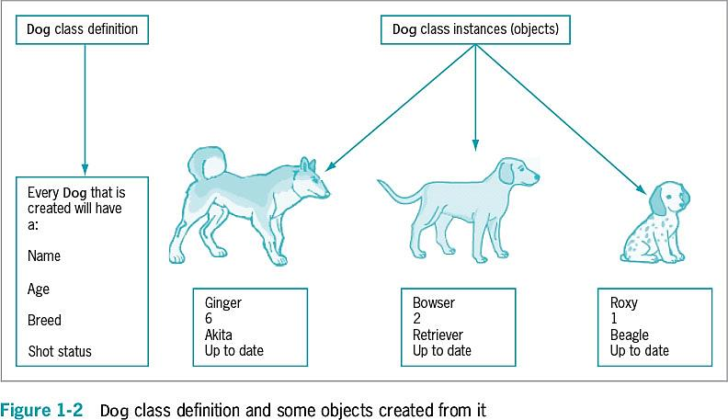
Understanding Classes, Objects, and Encapsulation (cont’d.)
Java Programming, Eighth Edition

Slide 13
Understanding Classes, Objects, and Encapsulation (cont’d.)
Method
  A self-contained block of program code that carries out an action
  Similar to a procedure
Encapsulation
  Conceals internal values and methods from outside sources
  Provides security
  Keeps data and methods safe from inadvertent changes
Java Programming, Eighth Edition

Slide 14
Understanding Inheritance and Polymorphism
Inheritance
  An important feature of object-oriented programs
  Classes share attributes and methods of existing classes but with more specific features
  Helps you understand real-world objects
Polymorphism
  Means “many forms”
  Allows the same word to be interpreted correctly in different situations based on context
Java Programming, Eighth Edition

Slide 15
Features of the Java Programming Language
Java
  Developed by Sun Microsystems
  An object-oriented language
  General-purpose
  Advantages
    Security features
    Architecturally neutral
Java Programming, Eighth Edition

Slide 16
Features of the Java Programming Language (cont’d.)
Java (cont’d.)
  Can be run on a wide variety of computers
  Does not execute instructions on the computer directly
  Runs on a hypothetical computer known as a Java Virtual Machine (JVM)
Source code
  Programming statements written in high-level programming language
Java Programming, Eighth Edition

Slide 17
Features of the Java Programming Language (cont’d.)
Development environment
  A set of tools used to write programs
Bytecode
  Statements saved in a file
  A binary program into which the Java compiler converts source code
Java interpreter
  Checks bytecode and communicates with the operating system
  Executes bytecode instructions line by line within the Java Virtual Machine
Java Programming, Eighth Edition

Slide 18
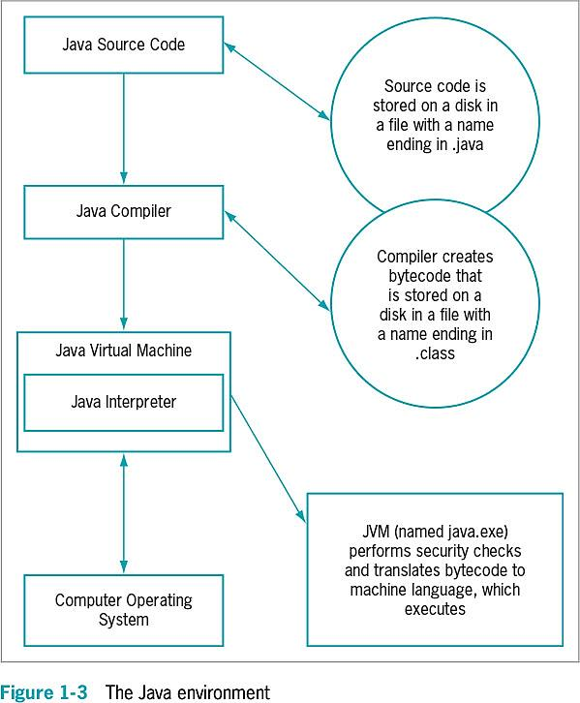
Features of the Java Programming Language (cont’d.)
Java Programming, Eighth Edition

Slide 19
Java Program Types
Applets
  Programs embedded in a Web page
Java applications
  Called Java stand-alone programs
  Console applications
    Support character output
  Windowed applications
    Menus
    Toolbars
    Dialog boxes
Java Programming, Eighth Edition

Slide 20
Analyzing a Java Application that Produces Console Output
Even the simplest Java application involves a fair amount of confusing syntax
Print “First Java application” on the screen
Java Programming, Eighth Edition

Slide 21
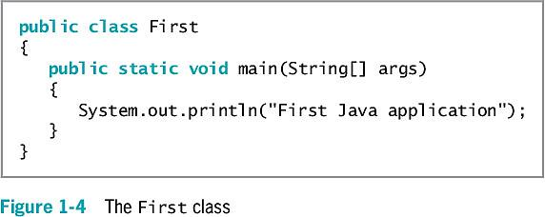
Analyzing a Java Application that Produces Console Output (cont’d.)
Java Programming, Eighth Edition

Slide 22
Understanding the Statement that Produces the Output
Literal string
  Will appear in output exactly as entered
  Written between double quotation marks
Arguments
  Pieces of information passed to a method
Method
  Requires information to perform its task
System class
  Refers to the standard output device for a system
Java Programming, Eighth Edition

Slide 23
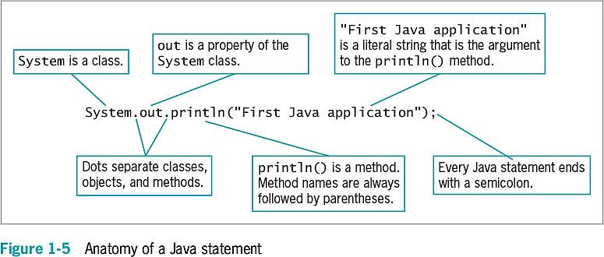
Understanding the Statement that Produces the Output (cont’d.)
Java Programming, Eighth Edition

Slide 24
Understanding the First Class
Everything used within a Java program must be part of a class
Define a Java class using any name or identifier
Requirements for identifiers
  Must begin with one of the following:
    Letter of the English alphabet
    Non-English letter (such as α or π)
    Underscore
    Dollar sign
  Cannot begin with a digit
Java Programming, Eighth Edition

Slide 25
Understanding the First Class (cont’d.)
Requirements for identifiers (cont’d.)
  Can only contain:
    Letters
    Digits
    Underscores
    Dollar signs
  Cannot be a Java reserved keyword
  Cannot be true, false, or null
Access specifier
  Defines how a class can be accessed
Java Programming, Eighth Edition

Slide 26
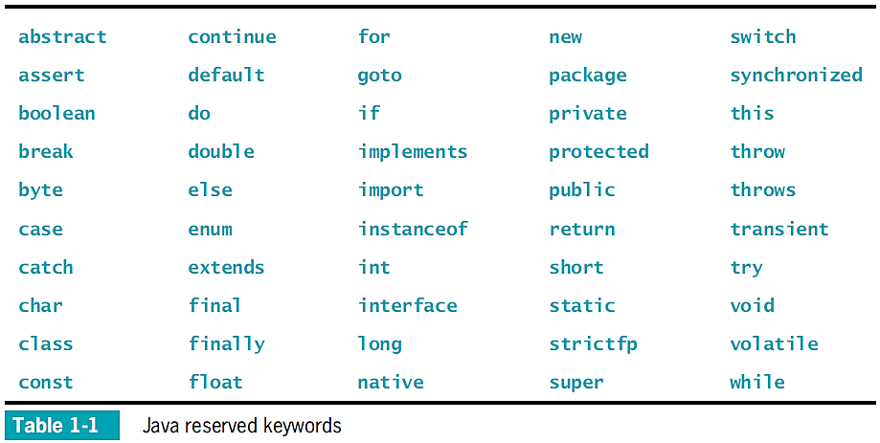
Understanding the First Class (cont’d.)
Java Programming, Eighth Edition

Slide 27
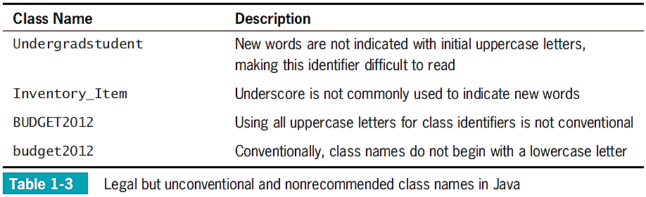
Understanding the First Class (cont’d.)
Java Programming, Eighth Edition

Slide 28
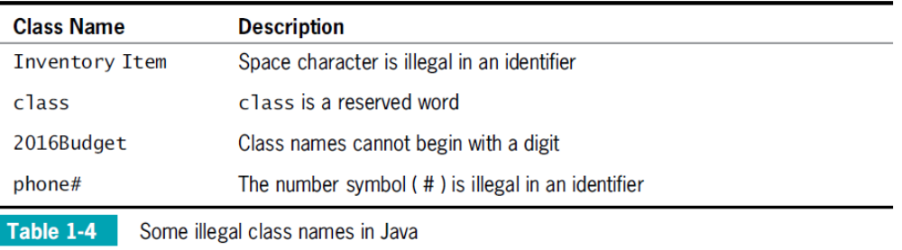
Understanding the First Class (cont’d.)
Java Programming, Eighth Edition

Slide 29
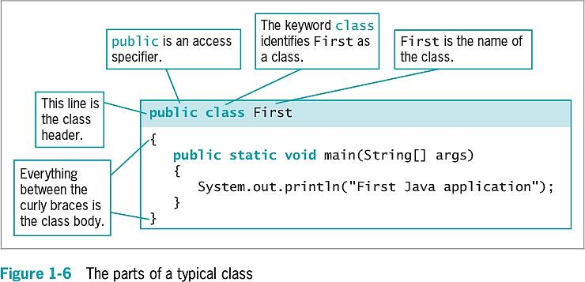
Understanding the First Class (cont’d.)
Java Programming, Eighth Edition

Slide 30
Indent Style
Use whitespace to organize code and improve readability
For every opening curly brace ( { ) in a Java program, there must be a corresponding closing curly brace
( } )
Placement of the opening and closing curly braces is not important to the compiler
Allman style used in text
Java Programming, Eighth Edition

Slide 31
Understanding the main() Method
static
  A reserved keyword
  Means the method is accessible and usable even though no objects of the class exist
void
  Use in the main() method header
  Does not indicate the main() method is empty
  Indicates the main() method does not return a value when called
  Does not mean that main() doesn’t produce output
Java Programming, Eighth Edition

Slide 32
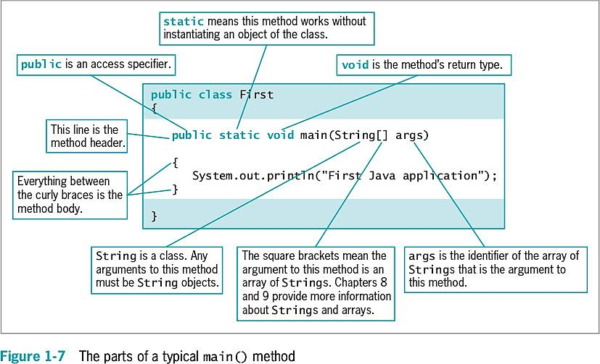
Understanding the main() Method (cont’d.)
Java Programming, Eighth Edition

Slide 33
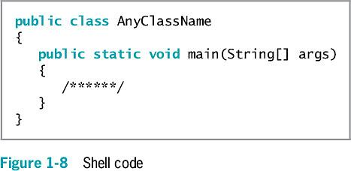
Understanding the main() Method (cont’d.)
Java Programming, Eighth Edition

Slide 34
Saving a Java Class
Saving a Java class
  Save the class in a file with exactly the same name and .java extension
    For public classes, class name and filename must match exactly
Java Programming, Eighth Edition

Slide 35
Java
Open Ecliplse
Download Debugging
Open GitHub Desktop
Learn how to use JOptionPane
Finish Programming Excercises
And Game Zone #1
Objective:
Students should be able to debug programs and understand how to create a new project
Java Programming, Eighth Edition

Slide 36
Compiling a Java Class and Correcting Syntax Errors
Compiling a Java class
  Compile the source code into bytecode
  Translate the bytecode into executable statements
    Using a Java interpreter
  Type javac First.java
Compilation outcomes
  javac is an unrecognized command
  Program language error messages
  No messages indicating successful completion
Java Programming, Eighth Edition

Slide 37
Compiling a Java Class and Correcting Syntax Errors (cont’d.)
Reasons for error messages
  Misspelled the command javac
  A misspelled filename
  Not within the correct subfolder or subdirectory on the command line
  Improper installation of Java
Java Programming, Eighth Edition

Slide 38
Correcting Syntax Errors
The first line of the error message displays:
  The name of the file where the error was found
  The line number
  The nature of the error
Next lines identify:
  The symbol
  The location
Compile-time error
  The compiler detects a violation of language rules
  Refuses to translate the class to machine code
Parsing
  Compiler divides source code into meaningful portions
Java Programming, Eighth Edition

Slide 39
Running a Java Application and Correcting Logical Errors
Run the application from the command line
  Type java First
Shows the application’s output in the command window
The class is stored in a folder named Java on the C drive
Java Programming, Eighth Edition

Slide 40
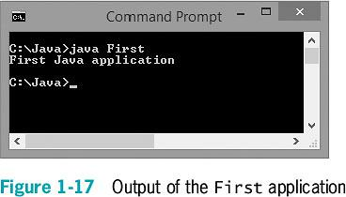
Running a Java Application and Correcting Logical Errors (cont’d.)
Java Programming, Eighth Edition

Slide 41
Modifying a Compiled Java Class
Modify the text file that contains the existing class
Save the file with changes using the same filename
Compile the class with the javac command
Interpret the class bytecode and execute the class using the java command
Java Programming, Eighth Edition

Slide 42
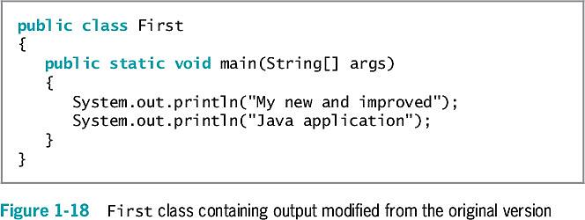
Modifying a Compiled Java Class (cont’d.)
Java Programming, Eighth Edition

Slide 43
Correcting Logical Errors
Logic error
  The syntax is correct but incorrect results were produced when executed
Run-time error
  Not detected until execution
  Often difficult to find and resolve
Java Programming, Eighth Edition

Slide 44
Adding Comments to a Java Class
Program comments
  Nonexecuting statements added to a program for documentation
  Use to leave notes for yourself or others
  Include the author, date, and class’s name or function
Comment out a statement
  Turn it into a comment
  The compiler does not translate, and the JVM does not execute its command
Java Programming, Eighth Edition

Slide 45
Adding Comments to a Java Class (cont’d.)
Types of Java comments
  Line comments
    Start with two forward slashes (//)
    Continue to the end of the current line
    Do not require an ending symbol
  Block comments
    Start with a forward slash and an asterisk (/*)
    End with an asterisk and a forward slash (*/)
Java Programming, Eighth Edition

Slide 46
Adding Comments to a Java Class (cont’d.)
Types of Java comments (cont’d.)
  Javadoc comments
    A special case of block comments
    Begin with a slash and two asterisks (/**)
    End with an asterisk and a forward slash (*/)
    Use to generate documentation
Java Programming, Eighth Edition

Slide 47
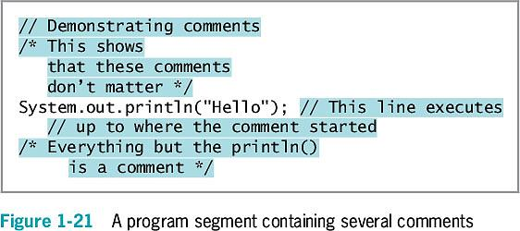
Adding Comments to a Java Class (cont’d.)
Java Programming, Eighth Edition

Slide 48
Creating a Java Application that Produces GUI Output
JOptionPane
  Produces dialog boxes
Dialog box
  A GUI object resembling a window
  Messages placed for display
import statement
  Use to access a built-in Java class
Package
  A group of classes
Java Programming, Eighth Edition

Slide 49
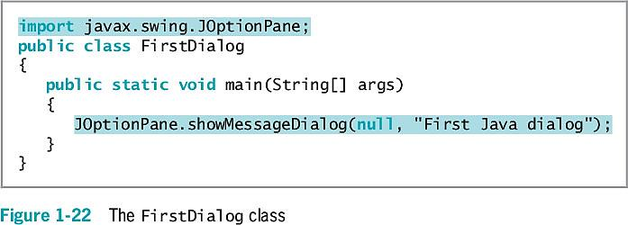
Creating a Java Application that Produces GUI Output (cont’d.)
Java Programming, Eighth Edition

Slide 50
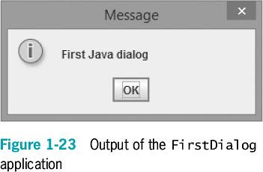
Creating a Java Application that Produces GUI Output (cont’d.)
Java Programming, Eighth Edition

Slide 51
Finding Help
Java API
  Also called the Java class library
  Provides prewritten information about Java classes
FAQs on the Java Web site
Java Development Kit (JDK)
  A software development kit (SDK) of programming tools
  Free to download
Java Programming, Eighth Edition

Slide 52
You Do It
Your First Application
Compiling a Java Class
Adding Comments to a Class
Creating a Dialog Box
Exploring the Java Web Site
Java Programming, Eighth Edition

Slide 53
Don’t Do It
Don’t forget the file’s name must match the class name
Don’t confuse these terms:
  Parentheses, braces, brackets, curly braces, square brackets, and angle brackets
Don’t forget to end a block comment
Don’t forget that Java is case sensitive
Don’t forget to end every statement with a semicolon
  Do not end class or method headers with a semicolon
Don’t forgot to recompile when making changes
Java Programming, Eighth Edition

Slide 54
Summary
Computer program
  A set of instructions that tells a computer what to do
Object-oriented programs
  Classes
  Objects
  Applications
Java Virtual Machine (JVM)
  A standardized hypothetical computer
Everything in a Java program must be part of a class
Java Programming, Eighth Edition

Slide 55
Summary (cont’d.)
Access specifier
  A word that defines circumstances under which a class can be accessed
All Java applications must have a method named main()
Program comments
  Nonexecuting statements
  Add to a file for documentation
javac
  A compile command
Java Programming, Eighth Edition

Slide 56
Binary
Java Programming, Eighth Edition

Slide 57
Vocabulary
Computer Program
Software
Logic
Machine Code
Syntax
Compiler
Interpreter
Bug
Variables
Dialog Box
Class
Attributes
Inheritance
Identifier
Pascal Casing/Upper camel casing
(), {}, [], <>
White Space
Static
Void
Package
Java Programming, Eighth Edition

Slide 58
Summary (cont’d.)
java
  An execute command
JOptionPane
  A GUI
  Provides methods for creating dialogs
Java Programming, Eighth Edition

